Slide 1
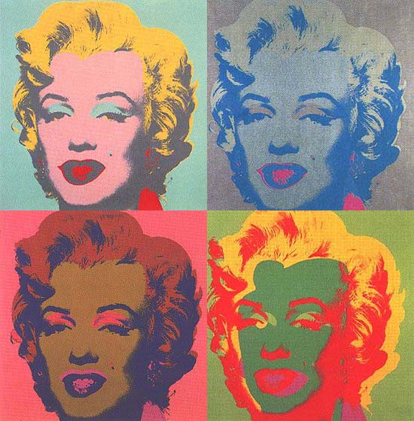
Research Design

Slide 2

Research Design
In this section we will be looking at research design in more depth.

Slide 3
Research Design
In particular quantitative methods of research design.

Slide 4
Research Design
In this part to the paper we will be looking at Quantitative research designs;
- Experimental Design
- Correlational Designs
- Survey Designs

Slide 5
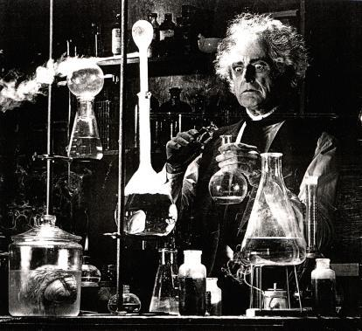
Research Design
Experimental design is also called the scientific method.

Slide 6
Research Design
Experimental Design
In an experiment you test an idea to determine whether has an influence on the outcome or dependent variables.

Slide 7
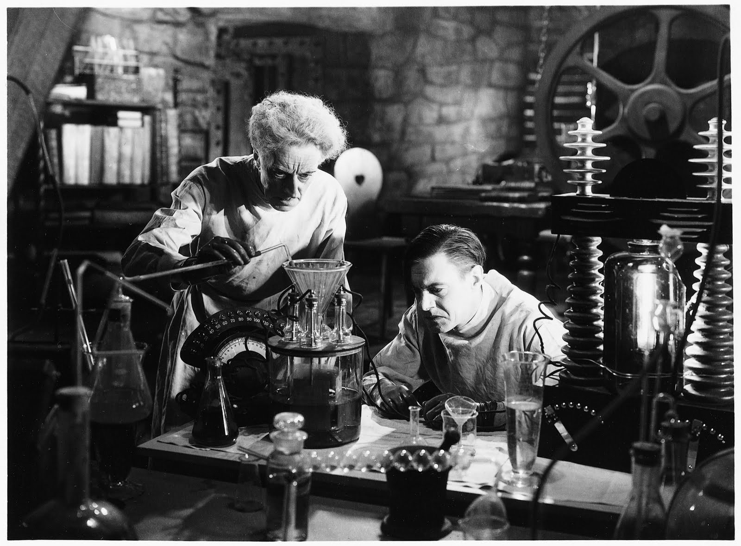
Research Design
Experimental Design
You use an experiment when you want to establish possible cause and effect between your independent and dependent variables.

Slide 8
Research Design
Experimental Design
This means that you attempt to control all of the variables that influence the outcome except the dependent variable. When the independent variable influences the dependent variable, we can say that the independent variable “caused” or “probably caused” the dependent variable.

Slide 9
Research Design
Experimental Design
In practice factors that participants bring to an experiment can never be totally controlled – some bias or error will always affect the outcome of a study.

Slide 10
Research Design
Experimental Design
How the researcher attempts to lessen these errors and biases is through the use of a control group. A control is a group that the experimental group is compared to. This is to see whether there is any evidence of change.

Slide 11
Research Design
Experimental Design
The control does not have an intervention or exposed to the independent variable. Therefore any change to the experimental group is said to been caused by the IV.

Slide 12
Research Design
Experimental Design
Also by systematically distributing this potential error among groups the researcher theoretically distributes the bias randomly.

Slide 13
Research Design
Experimental Design
Don’t confuse random assignment with random selection.

Slide 14
Research Design
Experimental Design
Extraneous factors are any influences in the selection of participants, the procedures, the statistics, or the design likely to affect the outcome and provide an alternative explanation for the results than what was expected.

Slide 15

Research Design
Experimental Design
All experiments have some random error or extraneous factors that you cannot control, but you can try to control extraneous variables as much as possible.

Slide 16
Experimental Design
Pretest-Posttest – A pretest provides a measure on some attribute or characteristics that you assess before they receive the treatment. Posttest is the measure that you carryout after the treatment.

Slide 17
Experimental Design
Pretest – is often called the baseline reading in that it sets up a starting point. What is measured is the difference between the pretest and posttest scores.

Slide 18
Research Design
Experimental Design
Pretest have advantages and disadvantages. They take time and effort to administer, they can rise participants expectations about the outcome. The pretest may influence the experimental treatment.

Slide 19
Research Design
Experimental Design
Matching of participants is a process of identifying one more personal characteristics that influence the outcome and assigning individuals with that characteristic equally to the experimental group and control group.

Slide 20
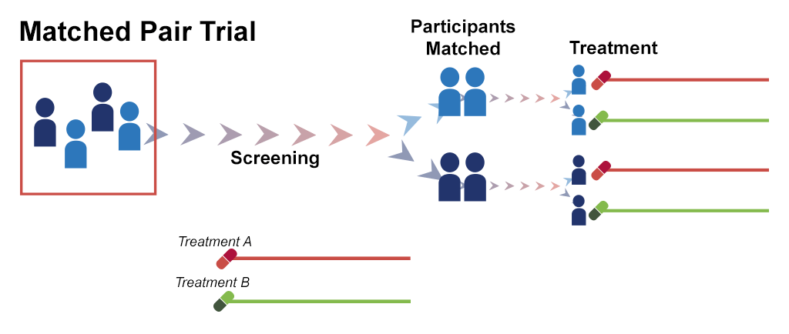
Research Design

Slide 21
Research Design
Experimental Design
In an experiment you need to focus on the independent variables. These variables influence or affect the dependent variables. The two major types of variables are treatment and measured variables.

Slide 22
Research Design
Experimental Design
In experiments treatment variables are independent variables that the researcher manipulates to determine their affect on the outcome, or dependent variable.

Slide 23

Research Design
Experimental Design
Treatment variables are categorical variables measured using categorical scales i.e. type of instruction (small group, large group).
When the researcher manipulates the treatment variable they are said to intervene.

Slide 24

Research Design
Experimental Design
In all experimental situations, you assess whether a treatment condition influences an outcome or dependent variable.

Slide 25
Research Design
Experimental Design
Group comparison is were the researcher obtains scores for individuals or groups and comparing the means and variance both with groups and between groups.

Slide 26
Research Design
Threats to Validity
- Statistical conclusion validity – refers to the appropriate use of statistics ( violating statistical assumptions)

Slide 27
Research Design
Threats to Validity
- Construct Validity – means the validity of inferences about constructs.

Slide 28
Research Design
Threats to Validity
Internal Validity – which relates to the validity of inferences drawn about the cause and effect relationship between the InV and the DV.

Slide 29
Research Design
Threats to Validity
External Validity – refers to the validity of the
cause-and - effect relationship being generalizable to the population.

Slide 30
Research Design
Threats to Internal Validity
- History
- Maturation
- Regression
- Selection
- Mortality
- Interaction with selection

Slide 31

Research Design
Threats to Internal Validity(relates to procedures)
- Testing(sometimes testing- retesting)
- Instrumentation

Slide 32

Research Design
Threats to External Validity
- Interaction of selection and treatment
- Interaction of setting and treatment
- Interaction of history and treatment

Slide 33
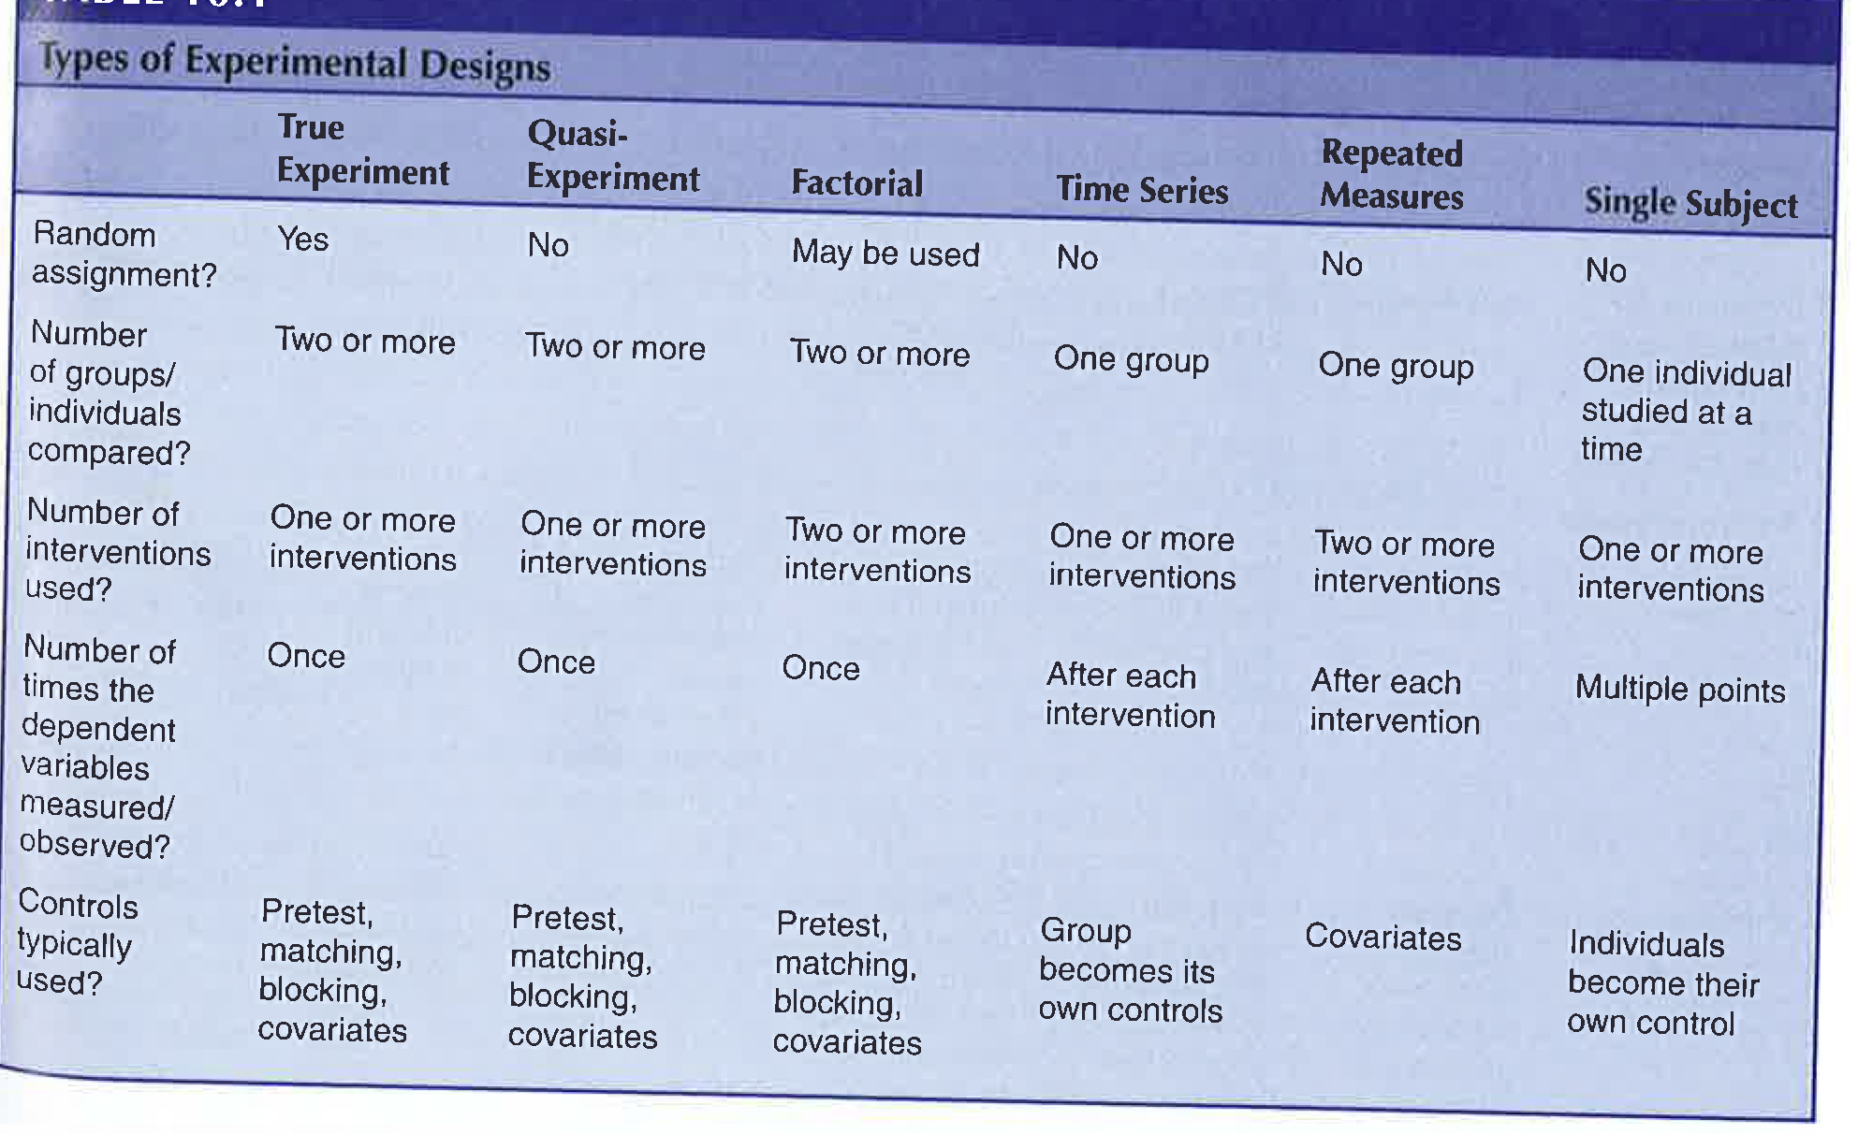
Research Design
Types of Experimental Design

Slide 34
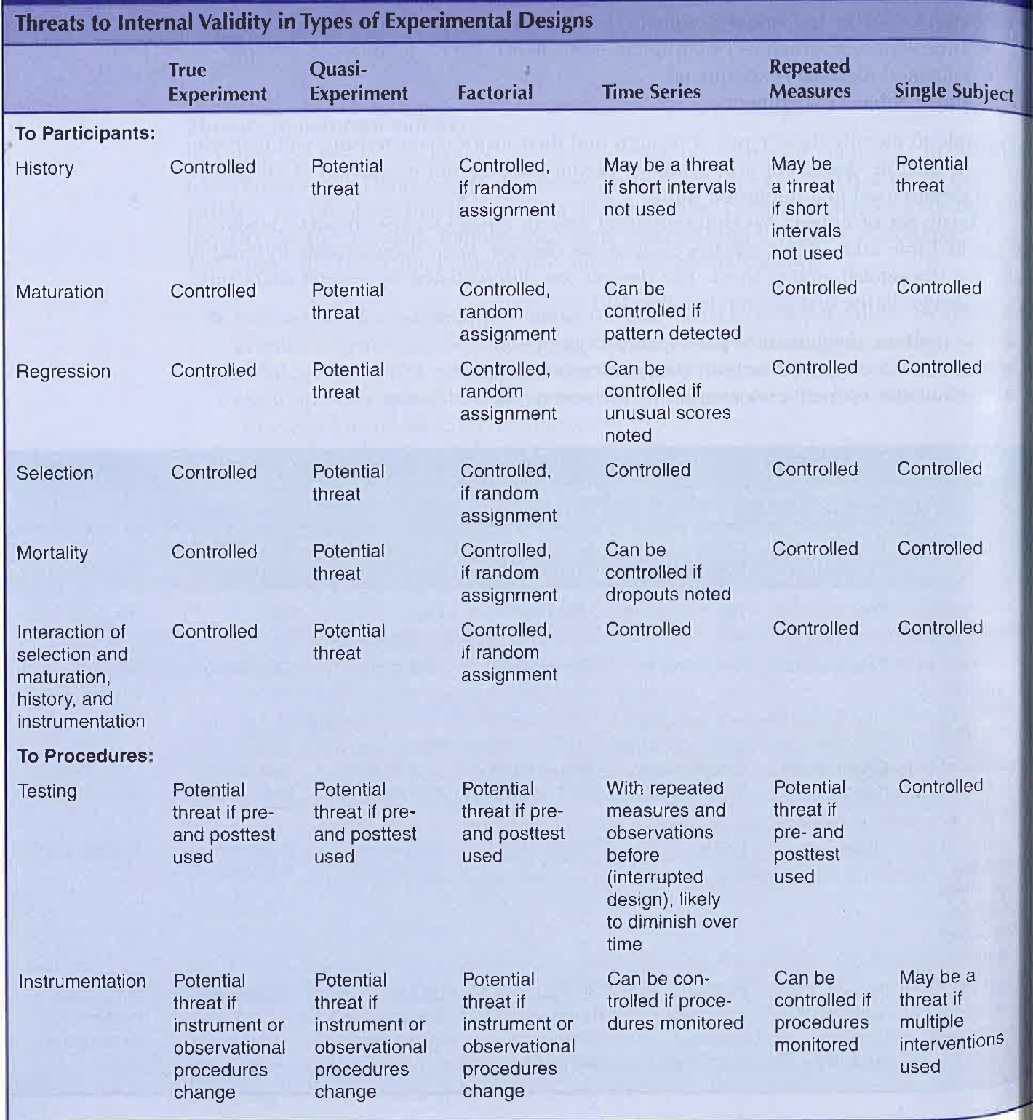
Research Design
Threats to internal validity in types of experimental design.

Slide 35
Design Research
Between Group Designs
- True experiments – are the most rigorous design
- Quasi experiment – used where researchers need to use intact groups.
- Factorial Design – where there is a need to study more than one treatment or factor

Slide 36
Research Design
Within-group or individual designs
- Time Series – where researcher can only study one group, study them over time, with multiple pre and posttests.
- Repeated Measures – all participants in a single group participate in all treatments.

Slide 37
Research Design
Single Subject Design
- Single subject research – used in behavioural analysis – uses a single subject with a baseline reading and administrating an intervention.
- A/B Design – trial period and intervention period.
- Multiple Baseline Design – used with more than one participant where the researcher changes the taking of the baseline reading

Slide 38
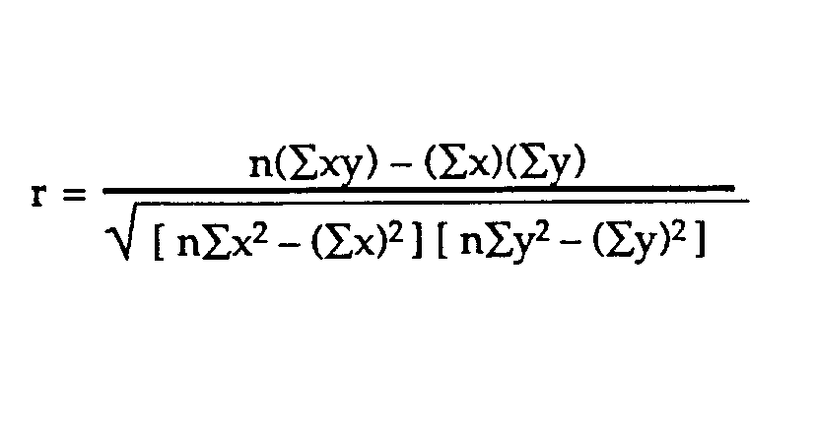
Research Design
Correlational Designs

Slide 39
Research Design
Correlational Designs – A correlation is a statistical test to determine the tendency or pattern for two or more variables or two sets of data to vary consistently.

Slide 40
Research Design
Correlational Designs
Investigators use a correlational statistical test to describe and measure the degree of association or relationship between to or more variables or sets of scores. In this design researchers do not attempt to manipulate or control variables; instead they relate using a correlation statistic.

Slide 41
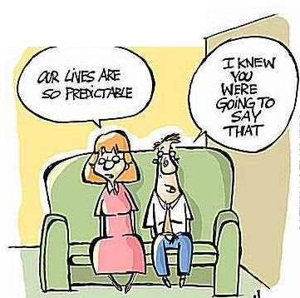
Research Desigh
Correlational Designs – Co-vary means that we can predict the score on one variable with knowledge about the individuals score on another variable.

Slide 42
Research Design
Correlational Designs
Explanatory Design is a correlational design the basic objective is to explain the association between or among variables. Where the researcher is interested in the extent to which two variables co-vary.

Slide 43
Research Design
Correlational Designs –
Prediction Design – researchers seek to anticipate outcomes by using certain variables as predictors. The purpose of Prediction design is to identify variable that will predict an outcome in correlational research. The outcome being predicted in correlational research is called the criterion variable.

Slide 44
Research Design
Correlational Designs
Prediction Design – Authors generally include the word prediction in the title. Usually measure predictor variables at one point in time, need to determine whether they have built a time dimension into the design. The idea is to forecast future performance.

Slide 45
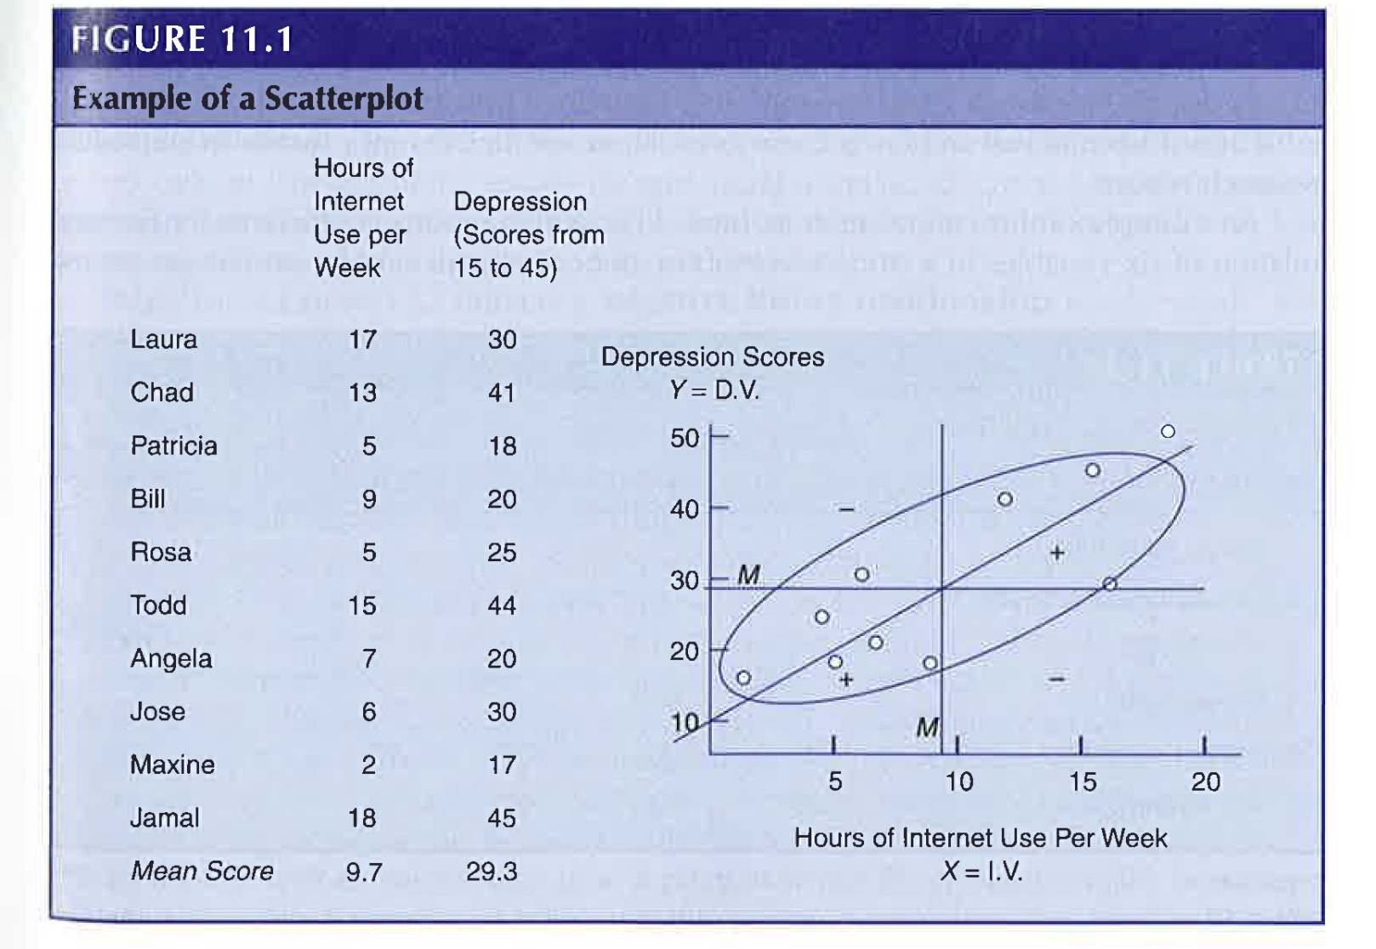
Research Design
Correlational Designs – Characteristics
Displays of scores, in correlational research you can plot these scores on a scatter plot or present them in a table.

Slide 46
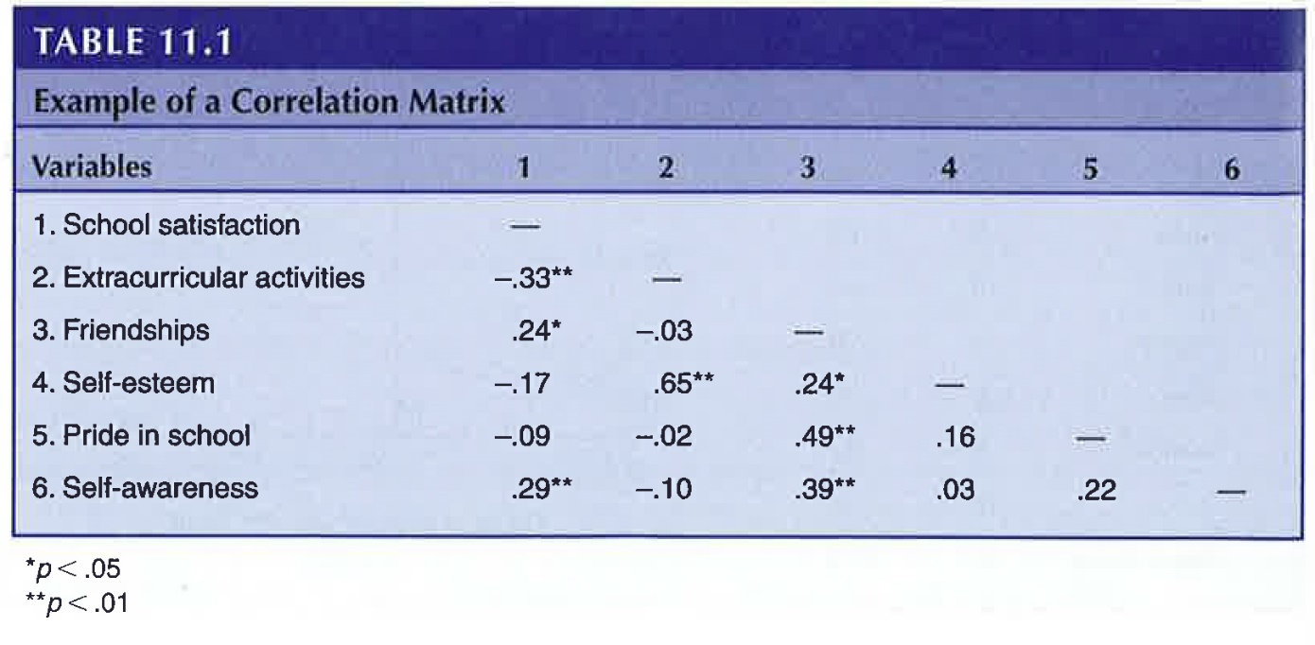
Research Design
Correlational Designs – Correlation Matrix, researcher typically display correlation coefficients in a matrix. It presents a visual display of all the coefficients for all the variables in the study.

Slide 47
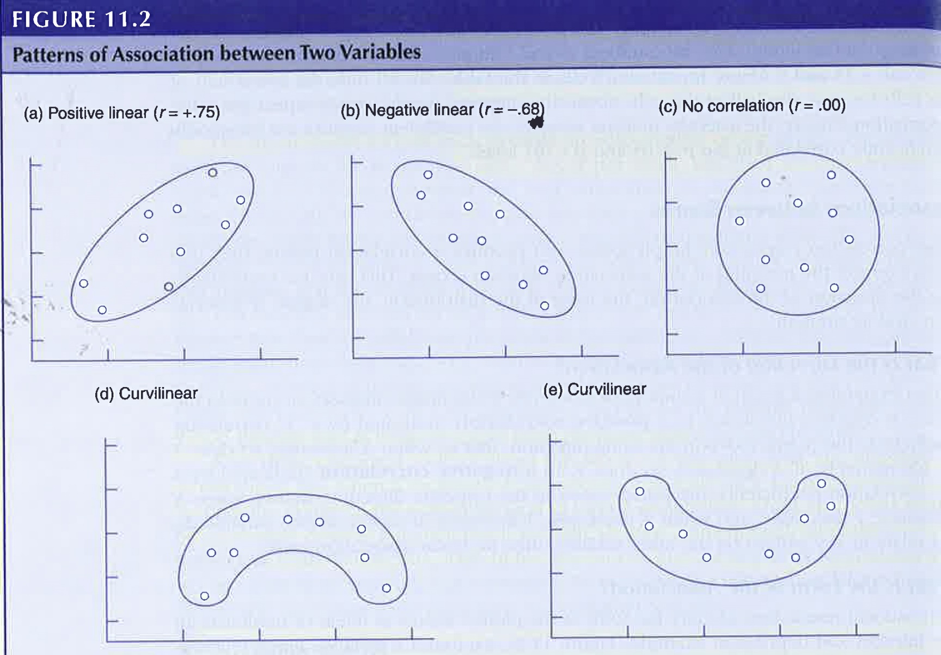
Research Design

Slide 48
Research Design
Correlational Designs – Association between scores
Uncorrelated and no linear relationship, uncorrelated means that there is no relationship between variables. The variables are independent of each other.
Curvilinear distribution shows a U-shaped relationship in the scores.

Slide 49
Research Design
Correlational Designs – Degree and Strength of Association;
Degree of association means that the association between the two variables of scores is a correlation coefficient of -1.00 to + 1.00, with 0.00 indicating that there is no linear relationship.

Slide 50
Research Design
Correlational Designs –
A coefficient of;
.20 to .35 – Only a slight relationship.
.35 to .65 – Useful for limited prediction.
.66 to .85 – Make useful predictions
.85 and above – Correlations of this range are typically achieved for studies of construct validity or test-retest reliability.

Slide 51
Research Design
Correlational Designs – Ethical considerations
- measuring appropriate controls
- Need to have adequate sample size for adequate power.
- Caution in the editing of data, and not to make up data.
- Fail to report contradictory findings.

Slide 52
Research Design
Correlational Designs – How to evaluate correlational studies
- Adequate Sample Size
- The display of correlational results in a matrix or graph.

Slide 53
Research Design
Correlational Designs – How to evaluate correlational studies
- An interpretation about the direction and magnitude of the association between two or more variables.
- Assessment of the magnitude of the relationship based on the coefficient of the determination, p values, effect size, or the size of the coefficient.

Slide 54

Research Design

Slide 55

Research Design
Survey Designs

Slide 56
Research Design
Survey Designs – are procedures in quantitative research in which investigators administer to a sample or entire population of people to describe their attitudes, opinions, behaviours, or characteristics of a population.

Slide 57

Research Design
Survey Designs – You use surveys to describe trends, such as community interests in some issue.

Slide 58
Research Design
Survey Designs – Types of Survey Designs
Cross-Sectional Survey Designs, collects data at one point in time. Has the advantage of measuring current attitudes or practices. They can collect information about current opinions, beliefs, attitudes and practices.

Slide 59
Research Design
Survey Designs – Types of Survey Designs
Longitudinal Survey Designs involve a survey procedure of collecting data about trends with the same population, changes in a cohort group or subpopulation, or changes in a panel group over time.

Slide 60
Research Design
Survey Designs – Types of Survey Designs
Trend Design, a form of longitudinal design the researcher identifies a population and examine changes within the population over time. i.e. Gallup Poll

Slide 61
Research Design
Survey Designs – Types of Survey Designs
Cohort studies, where the researcher identifies a subpopulation based on some specific characteristic and studies them over time.

Slide 62
Research Design
Survey Designs – Types of Survey Designs
Panel Studies, where the researcher examines the same people over time. Examine more than one group.

Slide 63
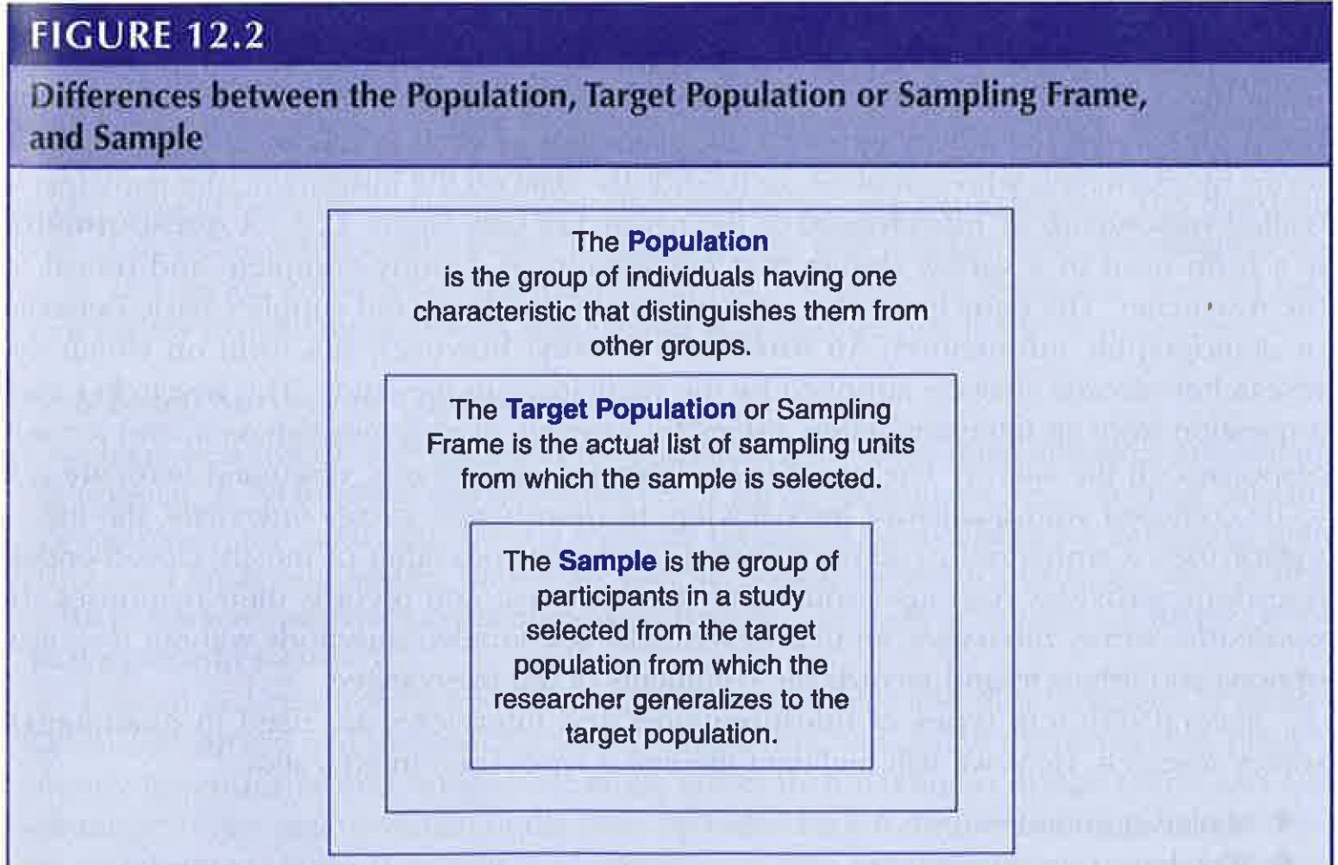
Research Design
Survey Designs – Characteristics of Survey Research
Sampling from a population - researchers study a sample of the population and generalize back to that population.

Slide 64
Research Design
Survey Designs – Characteristics of Survey Research
Questionnaires and Interviews, Questionnaire is a form used in survey where the participants complete and mail the form back to the researcher.
Interview the research asks the questions and records the answer on the interview form.
The difference between quantitative and qualitative is in the types of questions.

Slide 65
Research Design
Survey Designs – Characteristics of Survey Research
Mailed Questionnaires- useful for widely dispersed sample, generally get a poor return rate.
Web-based Surveys – generally poor response rate. Not randomly sampled, maybe biased towards a particular group.

Slide 66
Research Design
Survey Designs – Characteristics of Survey Research,
One-to-one interviews, good for asking sensitive questions, problems with anonymity.
Focus Group, Using a group generally no more than 6 to 8 individuals. They provide interaction within the group. The problem is sometimes finding consensus in the group, individual who may dominate the group.

Slide 67
Research Design
Survey Designs – Characteristics of Survey Research
Telephone interviews – good for a population that is geographically dispersed, cannot observe body language.

Slide 68
Research Design
Survey Designs – Instrument Design
Designing a good survey instrument is a challenging and complex process. At first you might consider modifying an instrument that already exists.

Slide 69
Research Design
Survey Designs – Instrument Design
When researchers design an instrument for data collection they generally follow three steps.
1. They write different questions. These include personal, attitudinal, behavioural, sensitive questions and closed and open end questions.

Slide 70
Research Design
Survey Designs – Instrument Design
When researchers design an instrument for data collection they generally follow three steps.
2. They use strategies for good question construction. This includes clear language, making sure that answer options do not overlap, and posing questions that are applicable to all participants.

Slide 71
Research Design
Survey Designs – Instrument Design
When researchers design an instrument for data collection they generally follow three steps.
3. They perform a pilot test of the questions

Slide 72
Research Design

